Slide 1


October 2015
1667 K Street, NW, Suite 1100 Washington, DC 20006-1660
^{202-452-8866 • 202-452-9010}
^{dsa.org}
© 2015 Direct Selling Association

Slide 2
Note on DSA Research
The data and insights in this report and other DSA research efforts are not possible without the active participation in industry research by DSA member companies.
If your company does not participate in all DSA industry research by submitting surveys and questionnaires when called upon, please do so! If you already do, we very much appreciate your support!
Member participation in research allows DSA to generate robust data that helps educate the public and allows DSA to advocate on behalf of the industry. Furthermore, as an immediate and direct benefit to your participation, your company receives the full research report at no cost as soon as it’s published. This gives you access to actionable data and insights that can help your company grow and a competitive advantage over those who don’t have it!
Note: All research data is submitted confidentially and reported only in the aggregate.
DSA engages third-party research vendors to ensure the confidentially of sensitive data.

Slide 3


Industry Research Committee
DSA
Joseph Mariano
PRESIDENT
Ben Gamse
MARKET RESEARCH MANAGER
Third Party Vendors
Committee Members
Pammie Strickland (Chair) AMBIT ENERGY
Jeff Morris (Past Chair) THE PAMPERED CHEF
Yani Aguayo STEMTECH INTERNATIONAL, INC.
Laura Chacon-Garbato HERBALIFE
Damien Douchet H2O AT HOME
Daniela Farmache Simkins AMWAY
Staci Glovsky NATURE’S SUNSHINE PRODUCTS INC.
Omobola Imoisili TEAM BEACHBODY
Judy Jones AMWAY
Jeff Kaufman ISAGENIX INTERNATIONAL
Hellen Liu RODAN + FIELDS
JJ LeBlanc MARY KAY INC.
Randi Neiner SHAKLEE CORPORATION
Jesse Stamm TAKE SHAPE FOR LIFE, INC. – MEDIFAST
Emily Trainor LULU AVENUE
Monica Wood HERBALIFE

Slide 4


Executive Summary
U.S. retail sales through the direct selling channel reached U.S.$34.5 billion in 2014, an increase of 5.5% over 2013.
  In the U.S., the categories of Wellness Products and of Services experienced increases in 2014, Personal Care reversed its recent decline with a slight increase in share, while Home and Family Care/Home Durables and Clothing and Accessories continued to experience decreasing shares.
  One-half of DSA’s largest 20 direct selling companies grew in 2014.
The number of people involved in direct selling reached a new high in 2014 at 18.2 million, which means approximately 14.9% of U.S. households have a member of the household involved in direct selling.
The DSA expects continued annual growth for the industry of
3% to 5% for the next three years, similar to the last three years.
The World Federation of Direct Selling Associations (WFDSA) reports global sales of $182.8 billion, an increase of 6.4% in constant U.S. dollars.
U.S. sales and seller figures are both at
record highs

Slide 5

Industry Outlook and Economic Context
Growth
5

Slide 6


This U.S. market increase of 5.5% in 2014 continued an upward trend that began after 2009 resulting in an industry record high
U.S. Estimated Retail Sales
Globally, the industry is also growing strongly.
Global direct retail sales estimated at $182.8 billion – up 6.4%
2011-2014 CAGR = 6.5%
% Change: | -4.3% | 0.8% | 4.6% | 5.9% | 3.3% | 5.5%
4.89% CAGR
  Source: 2015 Growth & Outlook Report, 2015 WFDSA Global Direct Selling Statistics

Slide 7
Growth is occurring in the industry across almost all levels of company size and tenure
50% of DSA’s top 20 largest direct selling companies experienced growth in 2014.
Companies predominantly selling through person-to-person methods experienced stronger growth in 2014 than those who sell through parties, groups or classes.
Among newer firms, founded in 2000 or after, 72% experienced sales growth in 2014, versus 39% of those with more tenure.
The smallest direct selling companies had growth of more than 50% in annual retail sales over 2013. Although, it’s important to note that these firms are growing from a smaller base than more established firms.
Sales of...
p9.8%
q3.5%
p8.3%
p50.4%
  Source: 2015 Growth & Outlook Report

Slide 8
2014 marked a return to estimated direct retail sales growth exceeding the U.S. economic growth
Estimated Direct Retail Sales and GDP ($U.S. billions)
4.89% U.S. Direct Selling Industry CAGR
3.93% U.S. GDP CAGR
  Source: 2015 Growth & Outlook Report

Slide 9


In the U.S., direct sellers offer a diverse set of products and services
Share of Direct Selling Industry Retail Sales in 2014
p
q
Percentage point change compared to 2013
Leisure & educational
p 0.5%
Clothing & accessories
q0.5%
Wellness
p 1.6%
Electronically connected health and wellness personal product
market will reach
$8 billion by 2018
Personal care
p 0.3%
Services
and other
p 0.2%
Energy deregulation strongly contributing to services growth
Home & family care/
home durables
q 2.1%
  Note: Totals may not sum to 100% due to rounding
  Source: 2015 Growth & Outlook Report; Consumer Electronics Association report of Technology Trends to Watch 2015.

Slide 10

DSA forecasts growth in the channel over the next three years with U.S. sales to reach approximately $39 billion in 2017
5.5%
growth
for 2014
3-5%
growth
expected annually for the next three years
  Source: 2015 Growth & Outlook Report

Slide 11






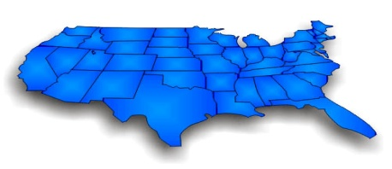

The number of direct sales representatives reached a new high in 2014
Number of People Involved in Direct Selling
(in millions)
The salesforce is diverse across
age groups (including Millennials)
Most independent
sales representatives
are female
About three-quarters
are married
About half have children
under 18 at home
46.3
AVERAGE AGE
 | 2008 | 2012
Females | 86.4% | 74.2% | q
Males | 13.6% | 25.8% | p
  Note: Totals may not sum to 100% due to rounding
74%
26%
14.9% of U.S. households have a direct sales representative
3 in 4
  Source: 2015 Growth & Outlook Report, 2014 National Salesforce Study
1 in 2

Slide 12
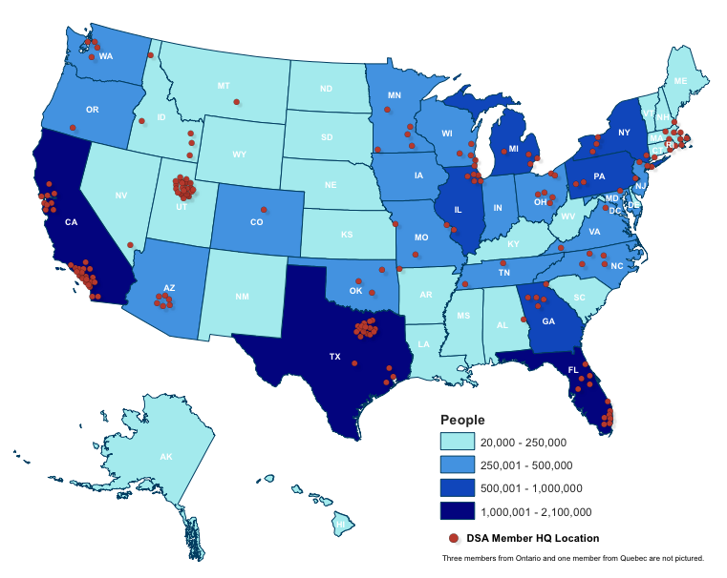
People involved in direct selling are widely dispersed across every state in the U.S.
California, Texas and Florida lead in the U.S.

Slide 13

Motivating Direct Sellers
Strengths of the Industry
13

Slide 14



With current representatives, motivations are diverse – both tangible and emotional
Top Motivations to BECOME a Direct Seller:
Entrepreneurial Motivations
Lifestyle Motivations
Product
48%
54%
57%
Long-term supplemental income
It gives me flexibility
I get the products
at a discount
  Source: 2014 National Sales Force Survey

Slide 15
All their motivations become stronger as reasons to continue as a direct seller
Top Motivations to BECOME a Direct Seller vs. CONTINUE as a Direct Seller:
Entrepreneurial Motivations
Lifestyle Motivations
Product
48%
62%
54%
65%
57%
62%
Long-term supplemental income
It gives me flexibility
I get the products
at a discount
  Source: 2014 National Sales Force Survey
  Source: 2014 National Sales Force Survey

Slide 16
Opportunity is strong with product sales to end customers
  60%
  Half
  Nearly 4 in 10
  …of direct sellers have
  11 or more customers that are not also direct sellers
  …of direct sellers say that more than 80% of their customers are repeat customers
  ...say they have five or more new potential customers who place an order in a typical month
  Source: 2014 National Sales Force Survey

Slide 17

Two-thirds of representatives are satisfied with their return on effort
Satisfaction with the Amount of Money Earned for Amount of Time Spent on Direct Selling Business
Nearly eight in ten say
the amount of income compared to the amount
of time invested was described accurately and fairly by the company
Very
63%
Total Satisfied
Somewhat
  Source: 2014 National Sales Force Survey
17
Notes:
The vast majority of respondents are satisfied with their direct selling experience and intend to continue
Direct sellers give their companies high marks on providing support to help them grow their businesses. Support comes in the form of recognition for their accomplishments, honest and accurate business materials, training, and the expertise of company personnel. Also of importance is the opportunity to become more active in the community.

Slide 18
Eight in ten representatives describe the experience of direct selling positively
Experience in Direct Selling
Gen Y are more likely to:
Say the experience
in direct selling has exceeded their expectations
Enjoy the flexibility and the short term supplemental income
82%
18%
  Source: 2014 National Sales Force Survey
18
Notes:
The vast majority of respondents are satisfied with their direct selling experience and intend to continue
Direct sellers give their companies high marks on providing support to help them grow their businesses. Support comes in the form of recognition for their accomplishments, honest and accurate business materials, training, and the expertise of company personnel. Also of importance is the opportunity to become more active in the community.

Slide 19
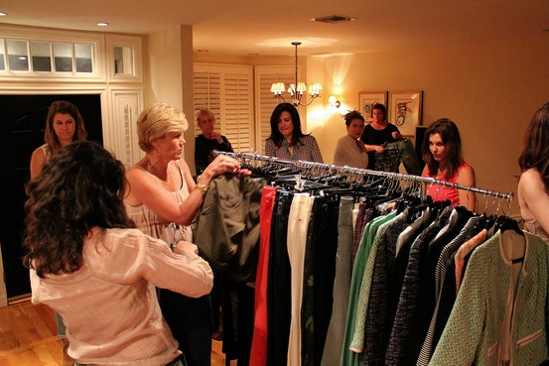

Consumer View of Direct Selling
19

Slide 20
Entrepreneurship and business dynamism are drivers of economic growth
56%
Reasons
1. Independence from an employer and being one’s own boss (65%)
2. Chance for self-fulfillment and the realization of their own ideas (62%)
of U.S. respondents to a global study conducted by a direct selling company have a positive attitude towards entrepreneurship
  Source: Amway Global Entrepreneurship Report 2013, GfK Roper

Slide 21
Favorability of the direct selling industry has improved
Favorability toward Direct Selling
Very Unfavorable
Very Favorable
18%
30%
1
2
3
4
5
6
7
8
9
10
24%
23%
  Source: Consumers’ Perceptions of the Direct Selling Industry 2012 National Survey Results

Slide 22
There is opportunity to move the large neutral group
Favorability toward Direct Selling
Very Unfavorable
Very Favorable
1
2
3
4
5
6
7
8
9
10
18%
52%
30%
  Source: Consumers’ Perceptions of the Direct Selling Industry 2012 National Survey Results

Slide 23

Consumers see direct selling as a way to support local entrepreneurs and receive knowledgeable personal service
Most Appealing and Important Characteristics of Direct Selling to a Potential Shopper
  Source: Consumers’ Perceptions of the Direct Selling Industry 2012 National Survey Results

Slide 24


The Internet and Direct Selling
Positive Impacts
24

Slide 25


Technology continues to be an opportunity for our industry
Top 15 US Retailers
Worldwide Digital Sales
(in billions)
Amazon $67.9
Apple $18.3
Staples $10.4
Wal-Mart $10.0
Sears $ 4.9
QVC $ 4.8
Netflix $ 4.4
Macy’s $ 4.2
Consumers
Ecommerce is expected
to grow 10% CAGR from 2014 to reach
$480 billion by 2019.
Convenience
42% order online from direct sellers
  Source: Direct Selling News commissioned Harris Poll; Internet Retailer “2014 Top 500 Guide” as cited by Wall Street Journal; Forrester
U.S. Direct Selling Strategic Insights

Slide 26




Social media is effective for selling, retaining customers and recruiting
Percent who say Social Media is effective as a way to...
Sell
37%
Retain
Customers
43%
Recruit
35%
  Source: 2014 National Sales Force Survey
  Social Media – Top 2 Box Effectiveness (Rated 4 or 5 on a 1 to 5 scale where 5 means “very effective”)

Slide 27





Relationships are still key in direct selling
“
Social and digital channels continue
to be the greatest opportunity for brands to reach their target market through meaningful and relevant relationship building content… Our goal is to invest in engaging content and digital tools they can use to improve their lives every day.
– DSA Member Company
(Data Tracker Q3-2014)
Representatives’ ratings of EFFECTIVENESS of how and where they recruit demonstrate the power of personal relationships
35% | 49% | 79%
Social Media such as Facebook, LinkedIn, Twitter, etc. | Home Parties | In Person
”
  Source: 2014 National Sales Force Survey
  Social Media – Top 2 Box Effectiveness (Rated 4 or 5 on a 1 to 5 scale where 5 means “very effective”)

Slide 28
Strategic Insights
The current climate for Direct Selling is excellent
Overall Economic Strength
The US economy is strong overall
  The Congressional Budget Office forecasts GDP will grow:
    4.2% in 2015, 4.6% in 2016 and 4.5% in 2017
Three-year US direct selling industry CAGR (Compound Annual Growth Rate) from 2011-2014 is 4.9% -- higher than US GDP growth of during this period (3.9%) by one percentage point

Slide 29
Strategic Insights
Focus on the competitive difference our model brings
Industry Strengths
U.S. sales and seller figures are at record highs
With our knowledge of consumers, message in terms that resonate to grow product and services sales
  Supporting a local small business person and continue to communicate other positive impacts of direct selling
  Convenience with personalization and high service level
  Knowledgeable sales people

Slide 30
Strategic Insights
Threats
Consumer expectations for convenience and ease via technology are increasing (for example Amazon.com)
The misunderstanding of the model among financial and regulatory sectors impacts the industry’s image overall

Slide 31
Strategic Insights
Opportunities
The business opportunity continues to offer additional income to many with flexibility to balance home and work life
Leverage the opportunity at an individual level to meet direct selling representatives’ motivations/needs
Approach consumers to purchase especially where loyalty is high and continue to build loyal consumers among Gen Y
Work to maintain relevancy with innovation in technology, access, tools, relationship building - look to the new, growing direct sellers for leadership on this
Evolve and enhance our image with the young and those less aware of our model

Slide 32

360 Degree Strategic Research Plan
National
Salesforce Study
Sales Strategy
Survey
Growth & Outlook Survey
Consumer Attitudes & Perceptions
Global Annual
Statistics Survey
Contact: Ben Gamse
Market Research Manager
bgamse@dsa.org
202-452-8866
Socio-Economic
Impact Study
2016
Quarterly DataTracker
REVAMPED
Members’ Needs Survey
Q1 2015
State of the Industry Report

Slide 33
Reports
Direct Selling Industry 2013 Sales Strategy Study
The survey was conducted online in 2013.
All DSA member companies were given the opportunity to participate, and 61 companies completed the survey.
The questionnaire averaged about 25 minutes in length.
Note: Due to the wide range of sizes of DSA member companies and the sales strategies they employ, there are considerable variations in responses to questions.
  We often report both mean (the average of all responses) and median (the middle value) to describe the data.
  The 61 member companies that participated in the study are a good cross-section of the DSA member companies, however, the data is representative only of these companies and cannot be generalized to the industry as a whole.
Consumers’ Perceptions of the Direct Selling Industry
2012 National Survey Results
The survey was conducted online in 2012 and 2008 and was national in scope.
It is designed to over-represent females because a large proportion of buyers in the direct selling industry are female.
The survey is representative of the national online population, which is similar but not identical to the full national population.
The age and race/ethnicity distribution of the population in this study mirrors the U.S. population of adults.
The questionnaire averaged about 15 minutes in length.
Direct Selling 2014 National Salesforce Study
This is a sizable study with over 20,000 direct seller respondents from 61 DSA member companies. Survey data was collected between March 13 - October 11, 2013. The scale and breadth of respondents from different companies provide a robust sample.
The data was weighted based on company size and method of survey distribution.
As with any satisfaction survey, it is those most satisfied who generally take the time to respond. And, those least satisfied are eager to give feedback.
2015 Growth and Outlook Report:
U.S. Direct Selling in 2014
The annual Growth & Outlook Survey is the primary resource for creating a comprehensive review of the status of 2014 direct selling in the U.S. The questionnaire for this year’s survey was distributed via email by the USDSA to direct selling companies on January 14, 2015, with a due date of March 13, 2015. Every effort is made to encompass the entire direct sales industry including non-members and the many small and start-up companies.
Out of 180 DSA member companies and 61 companies in the pending process, 108 firms participated in the survey this year, including 40 (80%) of the 50 largest members.

Slide 34
Definitions
  Direct Retail Sales – the dollar amount paid by the ultimate consumers of the products and services. Estimated Retail Sales are direct selling company revenues plus an estimated retail margin.
  Direct Seller – an individual eligible to order products/services during the year; people involved in direct selling may be called direct sellers, distributors, representatives, consultants or various other titles, and may participate in various ways, including selling the products themselves or through their sales organizations, providing training and leadership to their sales organizations, referring customers to the company and purchasing products and services for personal use. Compensation is ultimately based on sales and may be earned based on personal sales and/or the sales of others in their sales organizations. These individuals are independent contractors.
  Direct Selling - a business model that offers entrepreneurial opportunities to individuals as independent contractors to market and/or sell products and services, typically outside of a fixed retail establishment, through one-to-one selling, in-home product demonstrations or online.
  Employee – a person who is corporately hired to provide services to a direct selling company on a regular basis in exchange for compensation. (Does not include independent direct sellers as defined above).
  Party Plan Sales Strategy – the sale of a product or service in a group or class setting and away from a fixed location, often in the home of a host or hostess.
  Person-to-Person Sales Strategy – a one-to-one sales interaction generally involving a salesperson and one customer, away from a fixed retail location, often in the home of the customer or in a mutually agreeable location.

Slide 35
DSA Code of Ethics
The cornerstone of the Direct Selling Association's (DSA) commitment to ethical business practices and consumer service is its Code of Ethics. Every member company pledges to abide by the code's standards and procedures as a condition of admission and continuing membership in DSA.
The DSA Code of Ethics speaks to both the consumer and the seller. It ensures that member companies will make no statements or promises that might mislead either consumers or prospective salespeople. Pyramid schemes are illegal and companies operating pyramids are not permitted to be members of the DSA.
The DSA Code of Ethics is enforced by an independent code administrator who is not connected with any member company. The code administrator will do everything possible to resolve any complaints to the satisfaction of everyone involved, and has the power to decide on remedies. All member companies have agreed to honor the administrator's decisions.

